Slide 1
Acceleration of Matrix Decomposition and Machine Learning Algorithms on FPGA using Altera SDK for OpenCL 1st M.A.Sc Seminar
Presenter: Ryan Tang
Supervisor: Dr. Mohammed A. S. Khalid
Date: March 31, 2015
University of Windsor
Department of Electrical and Computer Engineering

Slide 2
Seminar Outline
Introduction
Problems
Tool (AOCL)
Problem Statement
Related Works
Research Goals and Strategy
Current Research Status
Summary
References

Slide 3
Introduction

Slide 4
Introduction: Background on Matrix Decomposition Algorithms
Matrix decomposition methods decompose a matrix into the product of a number of matrices.
Time Complexity O(n³)
Applications:
Solving of linear systems, finding matrix inverse, linear least squares method, etc.
Statistics, Machine Learning, Radar Signal Processing, Simulations, Optimizations, etc.
Algorithms that this research will implement:
LU decomposition, Cholesky decomposition, and QR decomposition.

Slide 5
Introduction: Matrix Decomposition Algorithms Overview 1
LU decomposition:
Decompose matrix A into lower triangular matrix L and upper triangular matrix U.
The matrix must not be singular
Method: Modified Gaussian Elimination (Doolittle/Crout)
About 2/3n³ floating point operations
Cholesky decomposition:
Decompose matrix A into lower triangular matrix L and upper triangular matrix L^{T}.
The matrix must be Hermitian positive semi-definite
Method: Modified Gaussian Elimination (Cholesky/Crout)
About 1/3n³ floating point operations

Slide 6
Introduction: Matrix Decomposition Algorithms Overview 2
QR decomposition:
Decompose matrix A into orthogonal matrix Q and upper (right) triangular matrix R.
Method: Modified Gram-Schmidt / Givens / Householder
About 2/3n³ floating point operations
Parallel forms of matrix decompositions:
Blocked/Panel:
Used for large matrices, applies blocked GEMM (matrix multiplication)
Batched:
Used for lots of smaller matrices, direct solving
Dense / Sparse:
Using dense matrix only for this research

Slide 7
Introduction: Background on Machine Learning Algorithms
Construct models based on training samples and use this model to make predictions when given new data
Classification of Learning Problems:
Based on label given or not:
Supervised learning, unsupervised learning etc.
Based on expected result:
Regression, Classification, Clustering etc.
Applications:
Image recognition, pattern recognition, machine vision, data mining, autonomous vehicle etc.

Slide 8
Introduction: Background on Machine Learning Algorithms cont.
Machine Learning Algorithms this research will implement:
K-means
Support Vector Machines (SVMs)
K-nearest neighbors (K-NN)
Will only explorer classification problems for simplicity
Computationally intensive when problem / feature size is large

Slide 9
Introduction: Machine Learning Algorithms Overview 1
K-means:
Clustering algorithm, unsupervised learning
Training:
Step 1: Initialization: randomly assign location to k centroids
Step 2: assign closest centroids to each training samples
Step 3: update centroid locations using 2.
Repeats steps 2 & 3 until converge
Classifying:
Class of test data = class of nearest centroid
Can be used to detect / choose features for other learning algorithms

Slide 10
Introduction: Machine Learning Algorithms Overview 2
SVM:
Supervised learning, based on logistic regression
Separates samples into different classes with a hyperplane
Can be linear, polynomial, etc.
Training:
Use optimization algorithms such as sequential minimal optimization (SMO) or gradient descent to find hyperplane parameters that maximizes margins
K-NN:
Instance-based Learning
Training = remember training samples
Classifying
Class of test data = class of the k-nearest neighbors (with weight function)
Require efficient data structure (kd-tree)

Slide 11
Introduction: Background on FPGAs
Field Programmable Gate Array
Reconfigurable logic, combined with hard logic
Used in embedded system applications
Pros:
Powerful and efficient computation devices
More flexible and less development cost compare to ASIC
Cons:
Difficult to program, require use of hardware description language (HDL) and extensive hardware knowledge
Longer development time and higher cost compare to GPGPU/CPU

Slide 12
Introduction: Background on High Level Synthesis
High Level Synthesis (HLS)
Translates high level language such as C, C++ and SystemC to low level HDL such as Verilog and VHDL
Established HLS Tools
Convert to RTL
C to Silicon (Cadence)
Catapult C (Mentor Graphics)
Synphony C Compiler (Synopsis)
Software Hardware Co-Design
LegUp (University of Toronto)
Vivado HLS (Xilinx)
Impulse C (Impulse Accelerated)
Special Language (BlueSpec)

Slide 13
Introduction: Introducing Altera SDK for OpenCL
HLS tool that compiles High Level OpenCL to Verilog targeting Altera FPGAs
Architecture
Host: C++ programs, manage resources and task
Device: OpenCL computation kernels, executed on FPGA
How does it work
Compile OpenCL to Verilog using AOC compiler and Qsys, then to device binary using Quartus II
Compile C++ host to binary using GCC/Visual Studio
Targeting High performance Computing (HPC) and Embedded Applications
Stratix V and Cyclone V FPGA support

Slide 14
Introduction: Background on OpenCL
Open Computing Language based on C99
Industry standard language for parallel and high performance computing
Explicit parallelism
task parallelism and data parallelism
Device support
CPU, GPU, FPGA(new), DSP(new), heterogeneous
Vender support
Intel, AMD, Nvidia, Altera, Apple, Xilinx(new), and more
Other Similar Solutions
OpenACC, OpenMP, CUDA (for CPU and GPGPU only)

Slide 15
Introduction: Comparisons
Altera OpenCL Cont.
Advantages:
Industry standard language
Low development time and cost
Streamlined design flow, expose power of FPGA to software engineers
FPGA has lower power consumption
Long life cycle (Don’t need to redesign the program for newer FPGAs)
Allows heterogeneous computing
Drawbacks
High compilation resource cost and time
In some case still requires hardware knowledge
(Current generation) lower floating point capability to GPGPU
Difficult to optimize / less transparent to debugging/profiling
The optimization in code reduces portability

Slide 16
Problem Statement

Slide 17
Problem Statement
Parallel Computing using GPU and CPU is a well researched topic in the past and current decade
FPGA are powerful and flexible, but far less utilized in parallel computing due to difficulty to program and long development time
Altera SDK for OpenCL allows acceleration of algorithms on efficient customized hardware without extensive hardware knowledge

Slide 18
Problem Statement (Cont.)
Can Altera SDK for OpenCL give FPGAs the capability to compete in parallel computing / HPC arena?
We would like to port parallel algorithms already efficiently implemented on CPU and GPU to FPGA and determine the effectiveness of the Altera SDK for OpenCL against established CPU and GPU platforms
Dense linear algebra and machine learning algorithms covers a few major types of parallel computing applications and are good starting points

Slide 19
Related Works

Slide 20
Related Works Matrix Decomposition Solution Overview
Standard Solution:
LAPACK and related BLAS 3 based libraries:
MKL (Intel CPU) [1]
cuBLAS (Nvidia GPU) [2]
MAGMA (heterogeneous) [3]
LU Tested on i7-3740QM (45W) and K2000m (55W)
MKL: 150 GFLOP/s Blocked;
cuBLAS: 175 GFLOP/s Blocked; 226 GFLOP/s Batched
MAGMA: 230 GFLOP/s Blocked;140 GFLOP/s Batched
(All results are single precision)

Slide 21
Related Works Matrix Decomposition on HPC
V. Volkov and J. Demmel presented an implementation of LU, QR and Cholesky decomposition on GPU (2008) [4]
309 ~ 340 GFLOP/s SP on GTX 280 GPU+CPU
70~75 GLOP/s SP on a Q6850 CPU
C. Cao et al. presented clMAGMA dense linear algebra library system (2014) [5]
LU: 326 GFLOP/s DP on 7970 GPU + 6 core Phenom II
Cholesky: 344 GFLOP/s DP on same hardware
QR: 347 GFLOP/s DP on same hardware
Speedup 5~6x versus CPU (MKL 11.1)

Slide 22
Related Works Matrix Decomposition on FPGA
W. Zhang developed a Verilog hand coded FPGA based direct linear system solver in master thesis (2008) [6]
LU: 47 GFLOP/s on Stratix III SL340 at 20 W
72x DSP (288x 18x18 Mul);
Was more power efficient than MKL on Xeon 5160
Altera Corporation presented DSP builder implemented Cholesky and QR on small matrices for radar DSP [7]
Cholesky: 92 GFLOP/s SP 360x360 matrices on Stratix V D5
1590x DSP (3180x 18x18 Mul); 2014/39MBits M20K
QR: 162 GFLOP/s SP 250x400 matrices on same hardware
Concluded that FPGAs better suited for smaller data size

Slide 23
Related Works Machine Learning K-means
M. Zechner and M. Granitzer presented CUDA implementation of K-means (2009) [8]
36 GFLOP/s on 9600 GT GPU, claim 14x over CPU
O. Segal et al. presented work on expending Java programming framework APARAPI to support Altera OpenCL SDK and Results of running Nbody Simulation and K-Means (2014) [9]
Implemented on Altera FPGA
5.2x-7x speed increase in K-Means vs. CPU

Slide 24
Related Works Machine Learning SVM
Austin Carpenter presented an CUDA implementation of Support Vector Machines. (2009) [10]
12-73x faster learning then LIBSVM CPU solver when using GTX 260 GPU
22-172x faster perdition then LIBSVM CPU solver with the same hardware
S. Wang et al. presented and Least Squares Support Vector Machine on Xilinx Virtex V FPGA (2011) [11]
6~218x over a Xeon CPU implementation when training sample is greater than 256

Slide 25
Related Works Machine Learning K-Nearest Neighbors
H. Hussain et al. presented an dynamically reconfigurable kNN classifier implementation on Xilinx Virtex 4 FPGA (2012) [12]
76x ~ 68x faster than Matlab implementation on Pentium Dual-Core E5300
I. Stamoulias and E. Manolakos presented implementation of kNN classifier on Xilinx Virtex 5 FPGAs (2013) [13]
Was 10 times slower then an earlier (2008) GPU implementation at large problem size but was considerably more power efficient
Quoted GPU implementation claimed to be 100x faster than CPU of its time

Slide 26
Research Goals and Strategy

Slide 27
Research Goals and Strategy Goals
To implement LU, Cholesky and QR decomposition methods on FPGA using Altera SDK for OpenCL.
To implement regressions, SVM, k-means, and KNN machine learning algorithms on FPGA FPGA using Altera SDK for OpenCL.
To implement the stated algorithms on CPU and GPU using highly efficient library such as cuBLAS, MAGMA, MKL, GPUMLib
Compare performance, power efficiency and numerical accuracy.
Use the data obtained to evaluate the capability of Altera SDK for OpenCL.

Slide 28
Research Goals and Strategy Strategy
Phase 1:
Implement the algorithm on CPU without parallelism. Study the algorithms and determine the best way to implement them on parallel platforms
Phase 2:
Implement the algorithms on FPGA using Altera SDK for OpenCL
Phase 3:
Implement the algorithms on CPU and GPU using available libraries and compare performance, power efficiency and numerical accuracy with FPGA implementations.

Slide 29
Current Research Status
Completed
Matrix Decomposition
Study the algorithms
Implementation of Blocked and Batch LU decomposition on FPGA, GPU and CPU using Altera OpenCL, CUDA SDK and MKL
Currently In progress
Matrix Decomposition
Implementation of Cholesky decomposition on FPGA, GPU and CPU and compare performance
Investigate the reason for low performance of LU on FPGA
Machine Learning
Taking machine learning open course
Implementing un-optimized k-means and gradient descent algorithm sequentially on CPU using C++

Slide 30
Summary
Matrix decomposition and machine learning algorithms are computationally intensive when problem size is large.
Currently fairly good software solutions exist to accelerate said algorithms using CPU and GPU.
HLS tools such as Altera SDK for OpenCL allows acceleration of algorithms using FPGA much easier then before.
This research attempts to find out if it is possible achieve higher performance with less power consumption using Altera SDK for OpenCL on FPGA than existing libraries on CPUs or GPUs.

Slide 31
References
[1] Intel Corporation “Intel® Math Kernel Library (Intel® MKL),” [Online]. Available: https://software.intel.com/en-us/intel-mkl
[2] NVIDIA Corporation, “cuBLAS,” [Online]. Available: https://developer.nvidia.com/cuBLAS
[3] Innovative Computing Laboratory, “Matrix Algebra on GPU and Multicore Architecture,” [Online]. Available: http://icl.utk.edu/magma/
[4] Volkov, V.; Demmel, J.W., "Benchmarking GPUs to tune dense linear algebra," International Conference for High Performance Computing, Networking, Storage and Analysis, 2008., pp.1,11, 15-21 Nov. 2008
[5] Cao, C. et al., “clMAGMA: high performance dense linear algebra with OpenCL,” In Proceedings of the International Workshop on OpenCL 2013 & 2014., Article 1, 2014
[6] Wei Zhang, Portable and Scalable FPGA-Based Acceleration of a Direct Linear System Solver, MASc thesis, University of Toronto, 2008

Slide 32
References (Cont.)
[7] Altera Corporation, Radar Processing: FPGAs or GPUs?, May 2013. [Online]. Available: https://www.altera.com/en_US/pdfs/literature/wp/wp-01197-radar-fpga-or-gpu.pdf
[8] Zechner, M.; Granitzer, M., "Accelerating K-Means on the Graphics Processor via CUDA," Intensive Applications and Services, 2009. INTENSIVE '09. First International Conference on , vol., no., pp.7,15, 20-25 April 2009
[9] Segal, O.; Margala, M.; Chalamalasetti, S.R.; Wright, M., "High level programming framework for FPGAs in the data center," Field Programmable Logic and Applications (FPL), 2014 24th International Conference on , vol., no., pp.1,4, 2-4 Sept. 2014
[10] A. Carpenter, "cusvm: A cuda implementation of support vector classification and regression, " 2009. [Online]. Available: http://patternsonascreen.net/cuSVM.html.

Slide 33
References (Cont.)
[11] Shaojun Wang; Yu Peng; Guangquan Zhao; Xiyuan Peng, "Accelerating on-line training of LS-SVM with run-time reconfiguration," Field-Programmable Technology (FPT), 2011 International Conference on , vol., no., pp.1,6, 12-14 Dec. 2011
[12] Hussain, H.M.; Benkrid, K.; Seker, H., "An adaptive implementation of a dynamically reconfigurable K-nearest neighbour classifier on FPGA," NASA/ESA Conference on Adaptive Hardware and Systems (AHS), 2012., pp.205,212, 25-28 June 2012
[13] Ioannis Stamoulias and Elias S. Manolakos. “Parallel architectures for the kNN classifier -- design of soft IP cores and FPGA implementations,” ACM Trans. Embed. Comput. Syst. 13, 2, Article 22 Sept. 2013

Slide 34
Thank you!

Slide 35
Appendix Background on Accelerator Hardware
Accelerator Card Designed for Altera OpenCL
DE5-net (Terasic)
PCIe-385N (Nallatech)
Stratix V A7 FPGA
622K logic elements
939K registers, 50 Mbits M20K block memory
256 DSP (27x27 Multiplier) floating point blocks
≤25W typically (Nallatech)
Include 4~8GB of DDR3 800MHz RAM
Include board support package (BSP)
Vendor implemented driver, libraries and memory control logic.

Slide 36
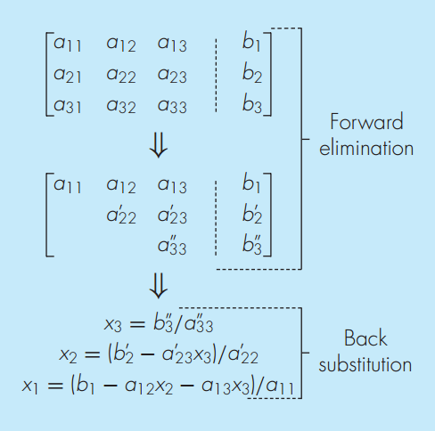
Appendix Gaussian Elimination
From Numerical
Methods for
Engineers 6th
P249

Slide 37
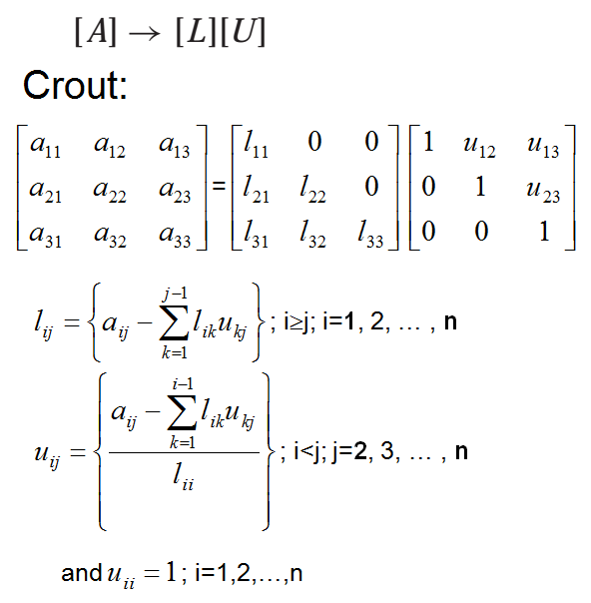
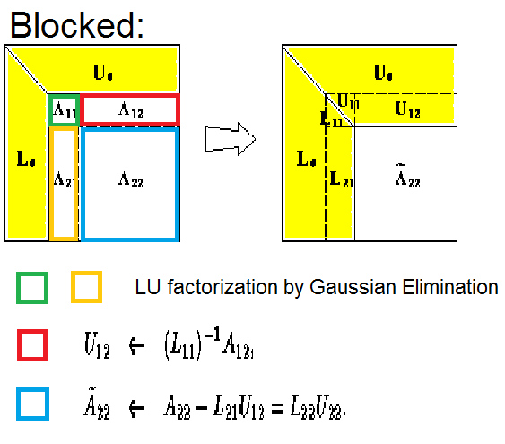
Appendix LU Decomposition

Slide 38
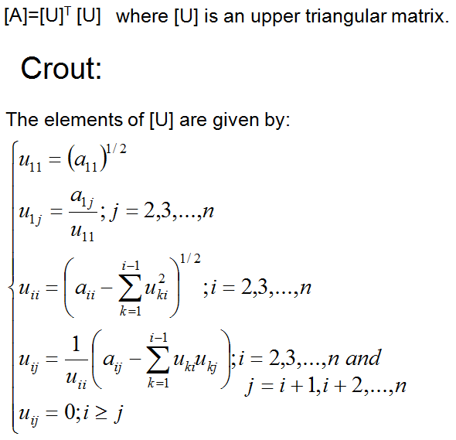
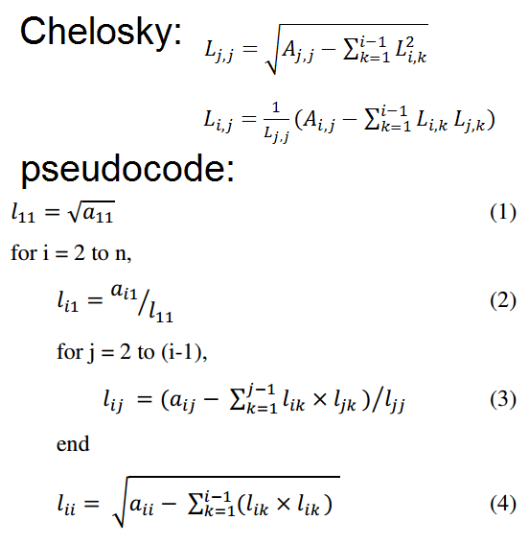
Appendix Cholesky Decomposition

Slide 39
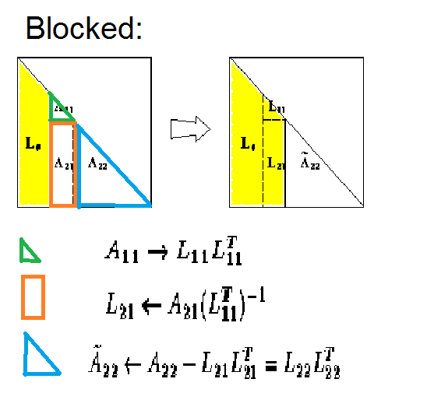
Appendix Cholesky Decomposition Blocked
Image
From
www.netlib.org
Maker of
LAPACK

Slide 40
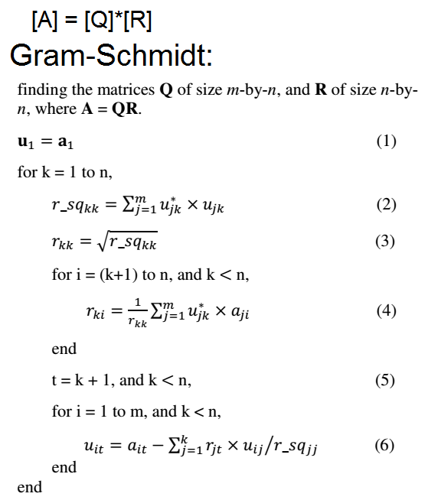
Appendix QR Decomposition

Slide 41
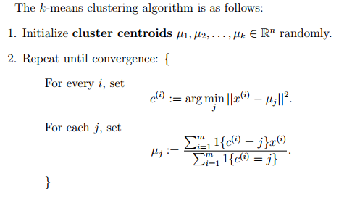
Appendix K-means
From CS 229 Lecture Notes

Slide 42
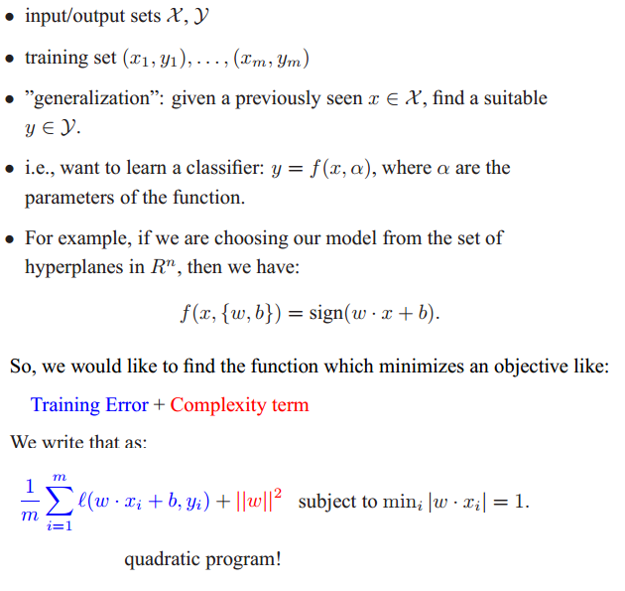
Appendix Support Vector Machine

Slide 43
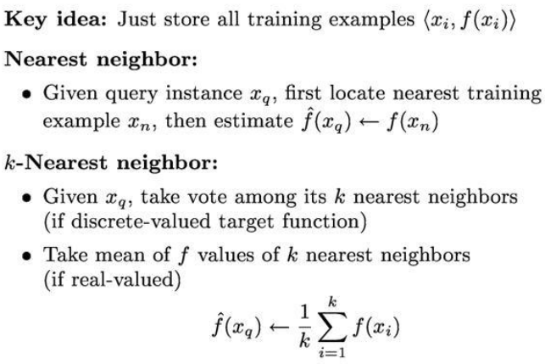
Appendix K-Nearest Neighbors
Form machlearning-001 course notes

